Slide 1
What’s For Dinner?
Food Recipe App
Team Svelte
Jihong, Jordan, Ahmed, Mikaaeel

Slide 2

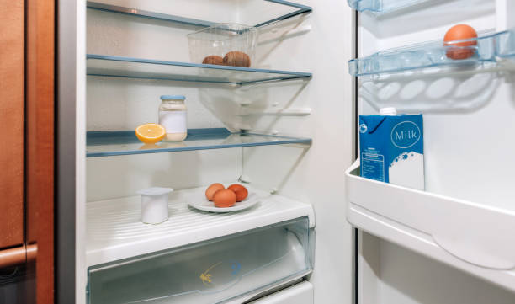
Elevator pitch

Slide 3
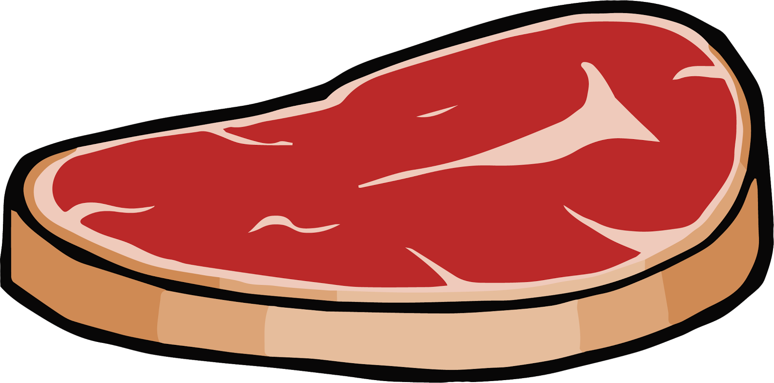
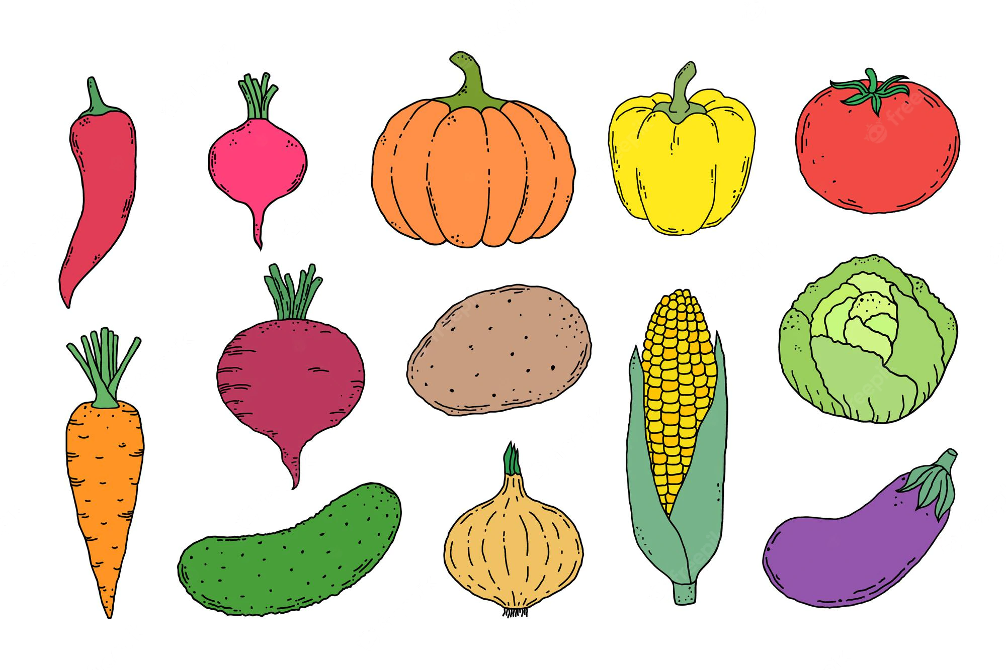
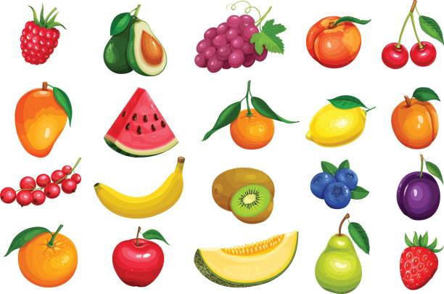
Concept
Users are able to type in three ingredients consisting of a meat, vegetable, and fruit. Thereafter, the user can click on the ‘Find my dinner’ button, which will generate the top six recipes consisting of those ingredients. The user can then click on the card they desire and will be directed to a page containing that recipe. There will also be the choice of adding a cocktail or beer to your dinner by clicking on either the ‘Random cocktail’ button, or the ‘Random beer’ button. This will generate a random cocktail or beer and will present the drink on screen in card format.

Slide 4
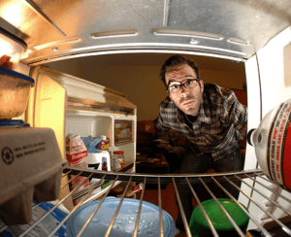
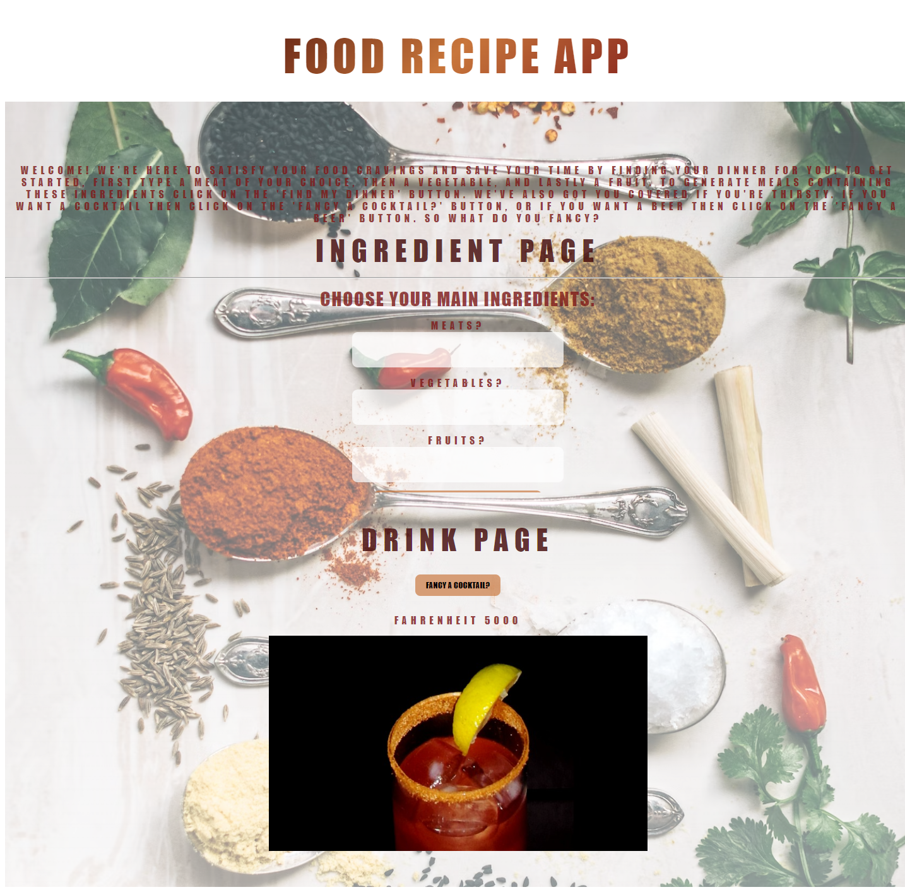
Concept
Motivation for development? This project was chosen to make life easier for those who are hungry and cannot decide what they want to eat. The concept behind this was to allow the individual to select what ingredients they enjoy the most, or the only ingredients they can find in the house. This allows them to find a recipe with these ingredients to save their time, or to try a completely new recipe for the first time. A random drink can also be selected if they are thirsty and cannot decide which drink they want.
User story -
As a user, I want to type in a meat, vegetable, and fruit to generate a random recipe, so that I can save my time or try new recipes.

Slide 5
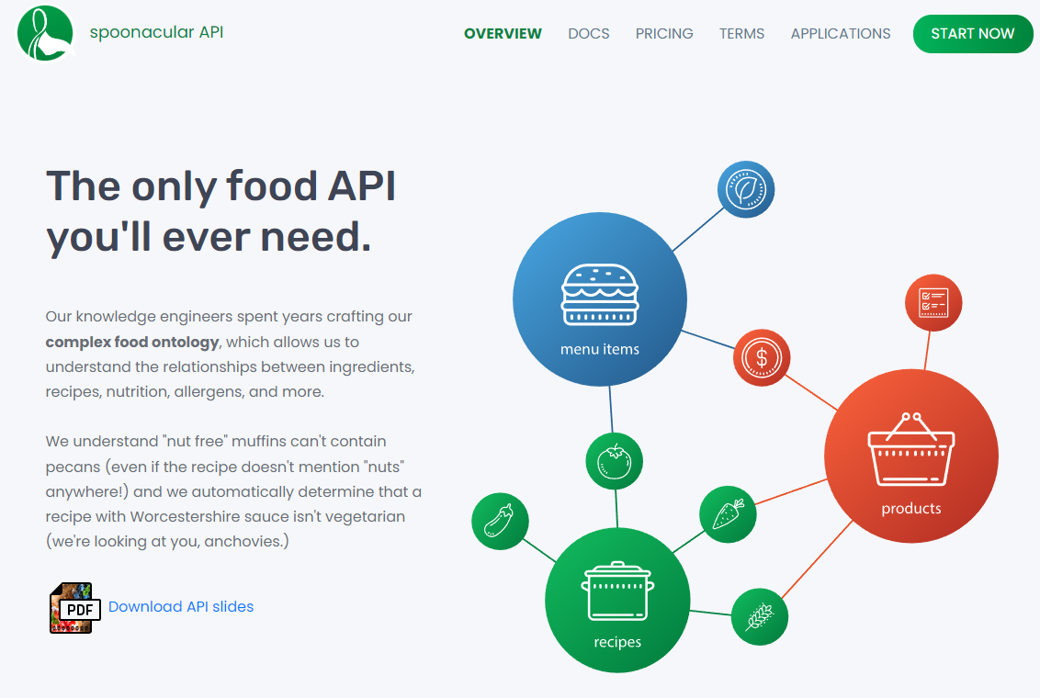
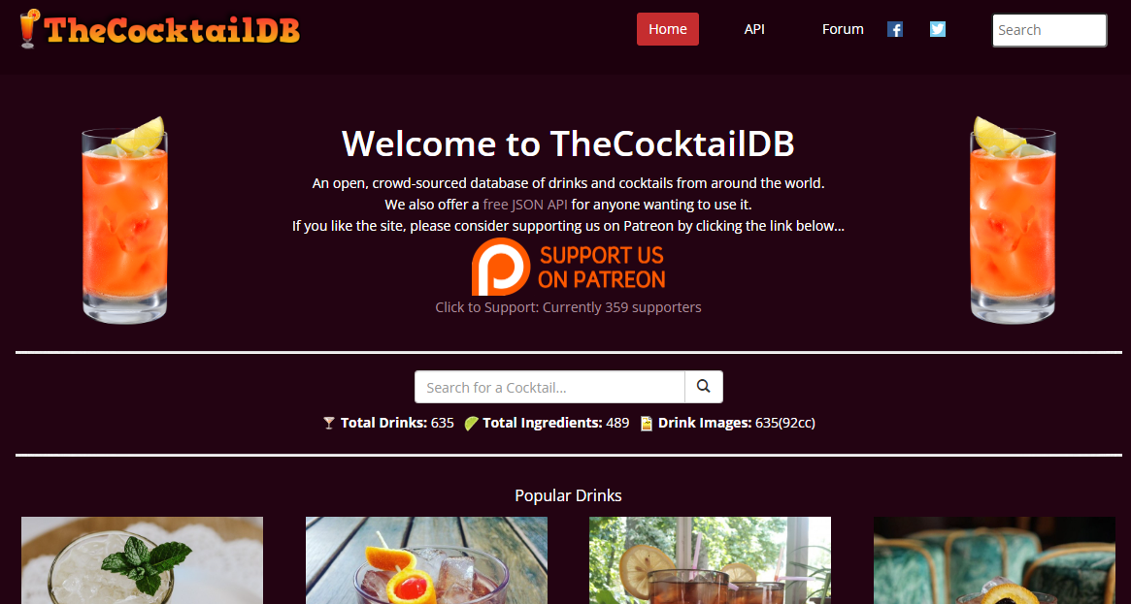
Process
Technologies used - The technologies used in this project are: HTML, CSS, JavaScript, Spoonacular API, thecocktaildb API, openfoodfacts API.
Breakdown of tasks and roles:
Mikaaeel - Role: HTML and presentation - Tasks: - Making HTML layout with semantic elements - Adding id’s and classes to elements for CSS and JavaScript files - Making the presentation
Ahmed - Role: CSS - Tasks: - Using CSS to style the HTML layout and make the UI look professional - Making the page responsive
Jihong - Role: JavaScript ingredients section - Tasks: - Using JavaScript to manipulate the DOM by adding functions and event listeners to buttons to display the recipes - Fetching these recipes from the Spoonacular API
Jordan - Role: JavaScript drinks section - Tasks: Using JavaScript to manipulate the DOM by adding functions and event listeners to buttons to display the drinks using thecocktaildb API, and openfoodfacts API.

Slide 6
Process
Challenges: - Originally there was going to be a section for soft drinks and cocktails, but finding an API for soft drinks was difficult as no APIs could be found. The soft drinks section was then replaced with a beer section instead. - Merge conflicts at times along with making sure everyone's code was compatible with one another.
Successes: - When ingredients are typed into the input boxes and the button is clicked, the top 6 recipes containing those ingredients are generated onto the page by being fetched from the api using JavaScript. This will take the user to the responding page which has details on how to make this recipe. The same result is found for the drinks section. - The CSS used to style the HTML is professional and eye-catching, making the UI easy to navigate and use, therefore enhancing the user’s experience.

Slide 7

Demo

Slide 8
Directions for Future Development
To develop the application further, we would like to implement a section which displays previously searched ingredients and recipes made by the user. This will allow the user to recall recipes and ingredients they have previously tried, making it easier for them in the future so they can try new ingredients and new recipes.
To also further develop the cocktail api by using additional data on what ingredients are used to in the cocktail and how to make the drink. As well as this, we would like to add a link to the cocktail image which takes the user to the recipe page.

Slide 9
Links
Deployed App Link: https://gibbo3433.github.io/Project-1/
GitHub Repo Link: https://github.com/gibbo3433/Project-1

Slide 10
Thank You for listening to our presentation. If you would like to ask any questions about our project, then please feel free to.

